Slide 1
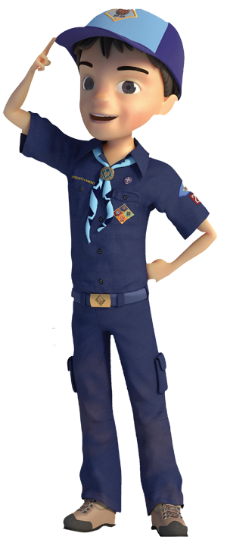
Welcome Pack 671
January, 2019
Pack Meeting

Slide 2
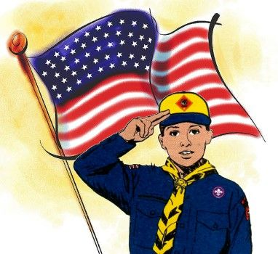
Opening Ceremony
Thank you
AOL Den!

Slide 3
Today’s agenda
8:30 - 9:15 Car check-in
9:15 - 9:45 Short Pack meeting
presentation
9:45 - 11:00 R A C E !
11:00 - 11:15 Pie-the-Cubmaster
11:15 – 11:30 Rewards and Recognitions
including den trophies, plus
popcorn prizes!
11:30 – 12:00 Open Division Race
including Open trophies
and creative trophies
12:00 - ? Breakdown, cleanup

Slide 4
Pinewood derby Trivia!!!
What year was the first pinewood derby?
1953
Why was the pinewood derby created?
Cub scouts too young for soap box derby
How long were the original pinewood derby tracks?
31 feet
How long are current pinewood derby tracks?
42 feet

Slide 5
Recent event: pack overnighter

Slide 6
Recent event: volo auto museum

Slide 7
Recent event: Tiger den

Slide 8
Recent event: wolf den

Slide 9
Recent event: bear den

Slide 10
New volunteers!!!
Mrs. Galvin
Service
Coordinator
Mr. Gutzke
Assistant
Cubmaster
Mr. Brink
Wolf
Den Leader

Slide 11
New volunteers!!!
Mr. Hoffman
Committee
Chair
(also currently Pack Trainer)
Mr. Short
Pinewood
Race Director (also currently Tiger Den Leader)

Slide 12
Please volunteer!
Whatever time and talent you can offer is greatly appreciated! Training is provided!
Immediate need for: Recruiting Coordinator
Camp Out Coordinator
Pack Committee Secretary
Additionally, we need volunteers for positions that will be vacated a year from now: Committee Chair
Advancement Coordinator
Popcorn Co-Kernel
Pack Trainer
Treasurer

Slide 13
Upcoming Events
Wednesday, Feb 6th: Committee Meeting
Feb 8-10: Indoor Winter Camp Out
Miller Cabin at Camp Crown
Please sign up and pay tonight
Saturday, February 16th: Blue and Gold Banquet
Sunday, March 3rd: Pack Planning Meeting
Saturday, March 9th: Roller Skating to celebrate
fundraising success!
Monday, March 18th: Regular Pack Meeting
Saturday, April 13th: Milwaukee Admirals Hockey

Slide 14
Blue and gold banquet
Superheroes theme this year!
Catered food!
Prize raffles throughout!
Entertainment is MR. FREEZE!
Pack covers most of the expenses but we do charge $15 per person to help defray costs (scouts and <5yrs free).
Friends of Scouting will be there to fundraise; please consider donating!
Please RSVP using the evite.

Slide 15
Leader awards
Key Scouter Award
This award recognizes committee members for noteworthy service.
Mrs. Ephgrave
Mr. Tate
Mr. Kenworthy
NEIC
Northstar District
Awards Dinner
Saturday
Feb 2nd
Silver Acorn Award
This award recognizes a Pack member for exemplifying a true volunteer spirit.
Mr. Padden

Slide 16
Pinewood derby trophies
1st, 2nd, and 3rd fastest in each group:
Lions + Tigers
Wolves
Bears
Webelos
Arrow of Light
Open
Most Superheroish Design
Most Supervillainish Design
Most Scouty Design
Each car will race four times against other cars in the group, once in each lane, to prevent any potential advantage/disadvantage. Heats will be random within each den. Although each heat will have an apparent ”winner”, finish order does not matter for the final results, the race is won strictly on fastest average time. In the open race, anyone can participate but only kids (both scouts and non-scouts) can win the open division trophy. Scouts who win a speed trophy are not eligible for the creative design trophies.

Slide 17
Pinewood derby rules hang on, almost there!
Good sportsmanship at all times,
for both scouts and adults!
Please do not touch the track or cars. Only the Boy Scouts and Leaders are allowed to handle the cars once they’ve been checked in. This includes after the cars go down the track and are resting at the bottom.
No scouts past the flags except when you are up to race, then please sit in the designated racer chairs.
These rules are for the safety of scouts, cars, and the race equipment.
Have fun and cheer for each other!

Slide 18
Race Director – Mr. Taylor
Donuts and coffee – Mr. Kenworthy
Transport of the track: Mr. Hunt, Mr. Message, Mr. Short
Inspection and Check-In: Mr. Hoffman, Mr. Brink
Check-in materials: Mrs. Ephgrave
Trophies: Mr. Hoffman
Pies: Mrs. Cherubini
Boy Scout volunteers: Leith Hoffman, Connor White, Zach Morrey, Joe Pec
And all other helpers!

Slide 19
Okay let’s race!!!!!!!!!!!!!

