Slide 1
Welcome Pack 671
March Pack Meeting

Slide 2
Opening Ceremony
Thank you
Bear Den!

Slide 3
Today’s agenda
Recent events
Health Forms
Cubmaster Minute
Call for Volunteers
Upcoming events
Scoutbook
Rewards and Recognitions
Lets Get to Know You x2
Door Prize!!!!!!!!!!!!!!

Slide 4
Through your generosity we raised more than $5000, exceeding our unit goal! This helps our individual Pack and our local Council!

Slide 5
Recent event: blue and gold banquet

Slide 6
Recent event: AOL den crossover

Slide 7
Recent event: roller skating

Slide 8
Recent event: tiger den

Slide 9
Recent event: wolf den

Slide 10
Recent event: bear den

Slide 11
Recent event: webelos den

Slide 12
Recent event: pack planning meeting

Slide 13
We still need more volunteers!
Whatever time and talent you can offer is greatly appreciated! Training is provided!
Immediate need for: Recruiting Coordinator
Camp Out Coordinator
Additionally, we need volunteers for positions that will be vacated a year from now: Committee Chair
Advancement Coordinator
Popcorn Co-Kernel
Pack Trainer

Slide 14
Cubmaster minute

Slide 15
Upcoming Events
Thursday, April 4th: Committee Meeting
Saturday, April 6th: Scouting for Food
Monday, April 22nd:
Pack Meeting

Slide 16
Upcoming Events
May 3-5: Spring Camp Out
Camp Lowden, Oregon, IL
Max 28 people, $12 per person

Slide 17
Upcoming Events
Thursday, May 9th: Committee Meeting
Saturday, May 18th:
Park Cleanup 9-12 Wildwood
AND
Cubmobile, 1:00, Caboose Park

Slide 18
Akela camp: Ma-ka-ja-wan summer camp for webelos and AOL scouts

Slide 19
2019-2020 calendar
Bicycling!
Racine Zoo!
Rocket Launch!
Renaissance Faire!

Slide 20
Scout jam, October 11-13
3 Venues!
30 Vendors!
The widest array of activities ever!
Registration starts in April

Slide 21
Health forms

Slide 23
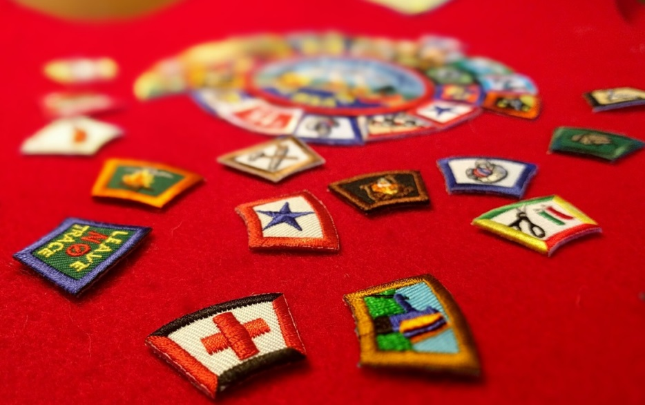
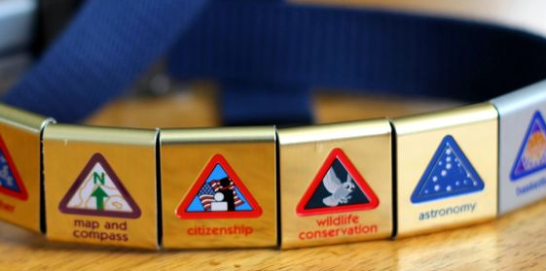
Awards and Recognitions

Slide 24
Segments and activity patches
Roller Skating Popcorn Seller’s Party
Popcorn Sellers
Kindergarten Registration Recruiting

Slide 25
LET’S GET TO KNOW a scout…..
What’s your…
Name?
Favorite food?
Favorite sports team?
Favorite school subject?
Favorite Movie?
If you could be any animal, what would you be and why?
If you could go anywhere in the world, where would you go?

Slide 26
LET’S GET TO KNOW a…..cubmaster!
Where were you born?
Tell us about your family
What is your previous Scouting experience?
What has been your career path?
What are your hobbies?
What is your future vision for the Pack?

Slide 28
Next month’s duties
Flag ceremony: Wolf Den
Skit or Song: Tiger Den

Slide 29
closing Ceremony
Thank you
Bear Den!

